Slide 1
Diwali Sales Analysis
By- Pratik Shinde

Slide 2
CONTENT OF THE PROJECT
Objectives:-
Increase sale In next year .
Improve Customer Experience by Analyzing sales data.
Increase Revenue.

Slide 3
Libraries
We have imported libraries as follows:
Pandas: Pandas allows us to analyze big data and make conclusions based on statistical theories. Pandas can clean messy data sets, and make them readable and relevant.
NumPy: NumPy can be used to perform a wide variety of mathematical operations on arrays. It adds powerful data structures to Python that guarantee efficient calculations with arrays and matrices and it supplies an enormous library of high-level mathematical functions that operate on these arrays and matrices.

Slide 4
Libraries
Matplotlib: Matplotlib is a popular data visualization library in Python. It's often used for creating static, interactive, and animated visualizations in Python. Matplotlib allows you to generate plots, histograms, bar charts, scatter plots, etc., with just a few lines of code.
Seaborn: Seaborn is a Python data visualization library based on matplotlib. It provides a high-level interface for drawing attractive and informative statistical graphics.

Slide 5
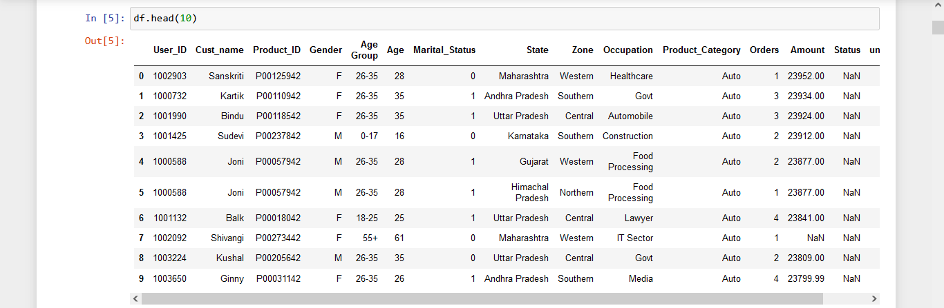
Implementation
The head() function is used to get the first n rows.
This function returns the first n rows for the object based on position.
It is useful for quickly testing if your object has the right type of data in it. Number of rows to select.

Slide 6
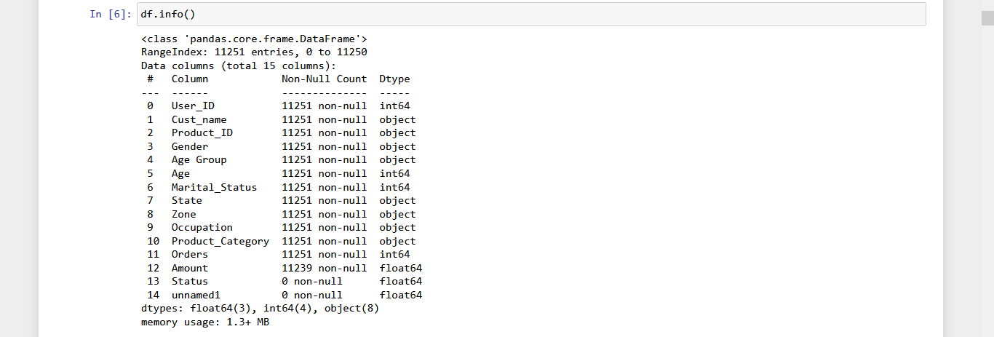
DataFrame Info()
The df.info() command prints the information about our dataset, including columns, datatypes of columns, non-null values, and memory usage.

Slide 7
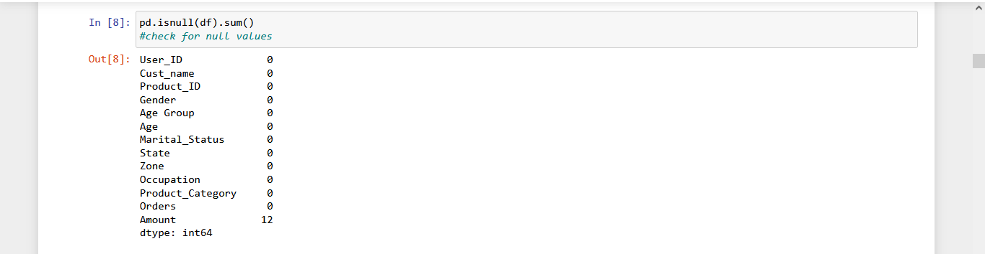
pd.isnull(df).sum()
The function dataframe. isnull(). sum(). sum() returns the number of missing values in the dataset.

Slide 8
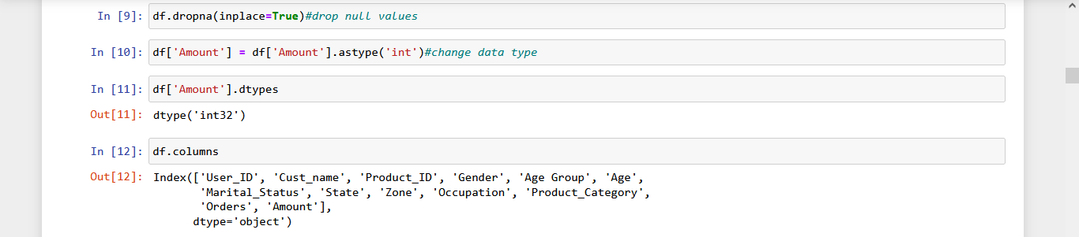

Slide 9
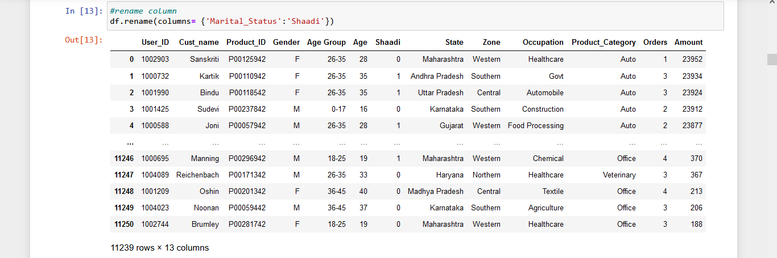

Slide 10
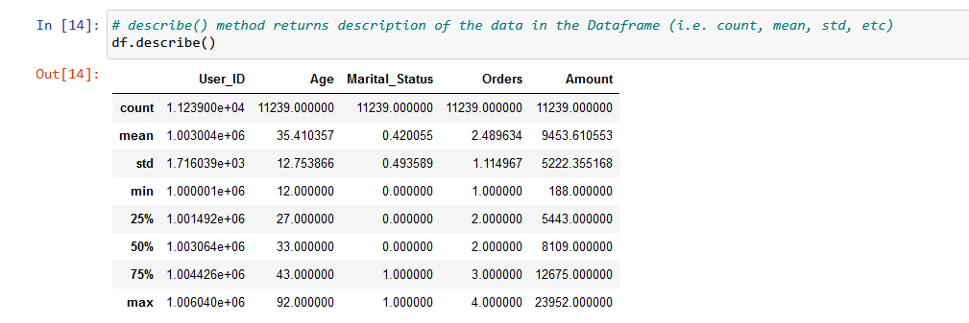
Pandas describe() is used to view some basic statistical details like percentile, mean, std, etc. of a data frame or a series of numeric values.

Slide 11
Exploratory Data Analysis
In Python, exploratory data analysis, or EDA, is a crucial step in the data analysis process that involves studying, exploring, and visualizing information to derive important insights. To find patterns, trends, and relationships in the data, it makes use of statistical tools and visualizations. This helps to formulate hypotheses and direct additional investigations.

Slide 12
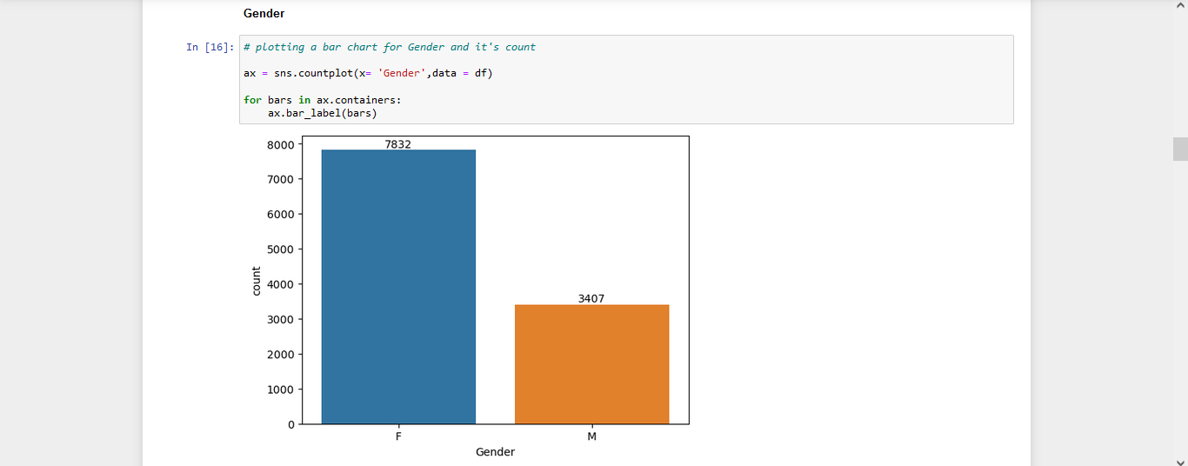
Here we can see Females are in high numbers than males as females count is 7832 and male count is 3407.

Slide 13
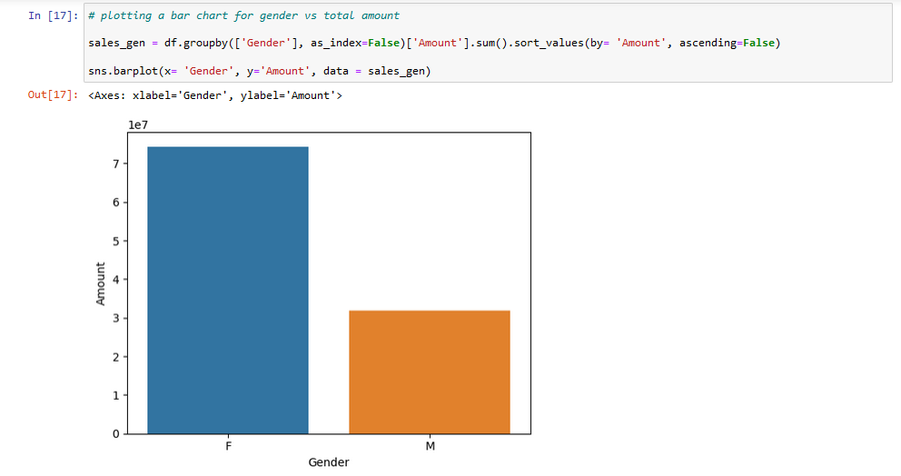
From below graphs we can see that most of the buyers are females and even the purchasing power of females are greater than men

Slide 14
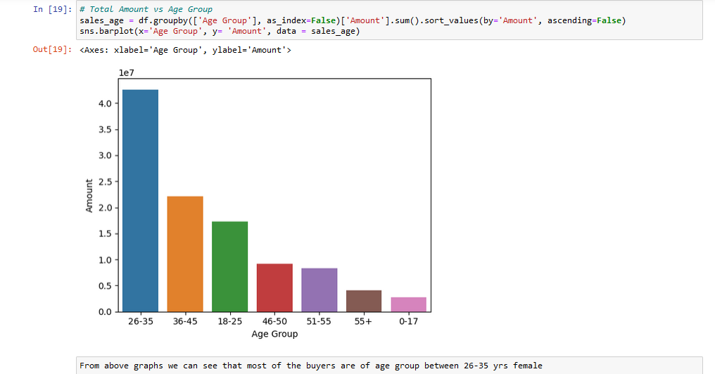

Slide 15
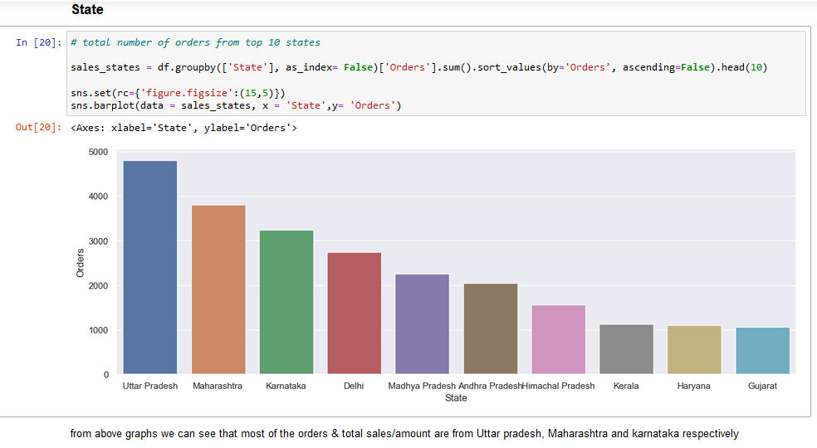

Slide 16
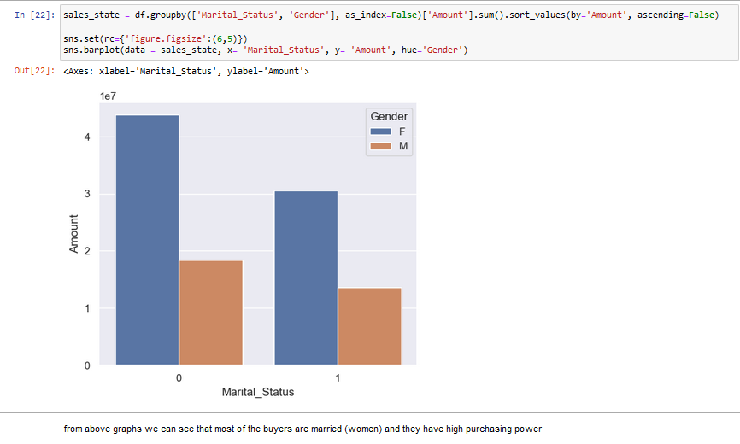

Slide 17
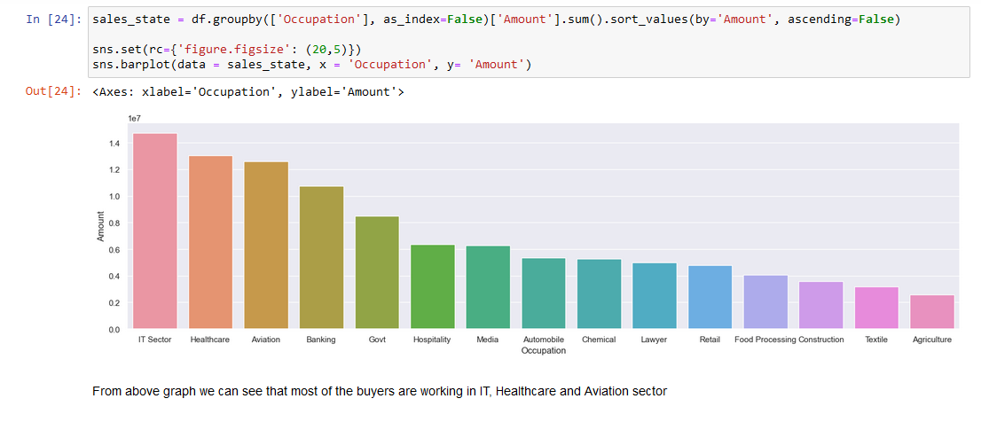

Slide 18
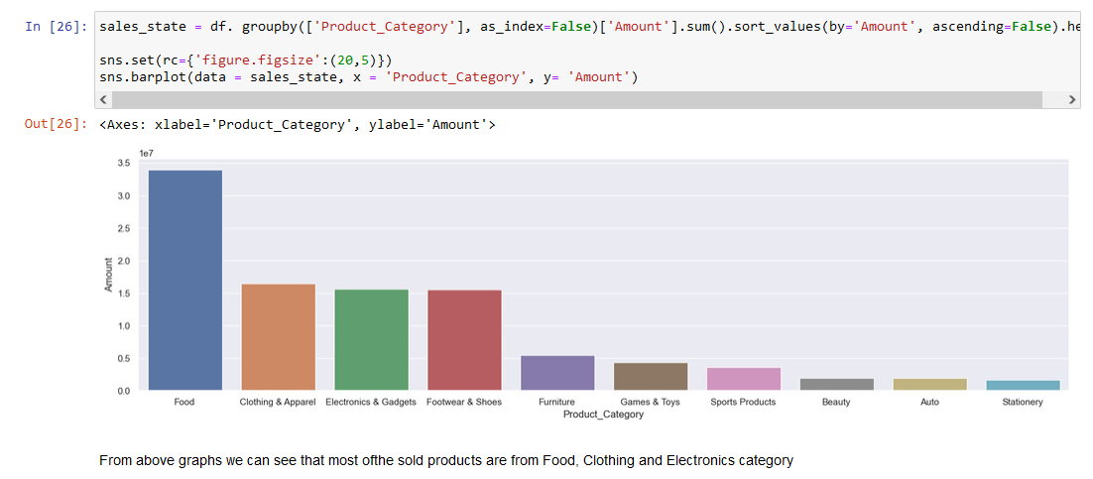

Slide 19
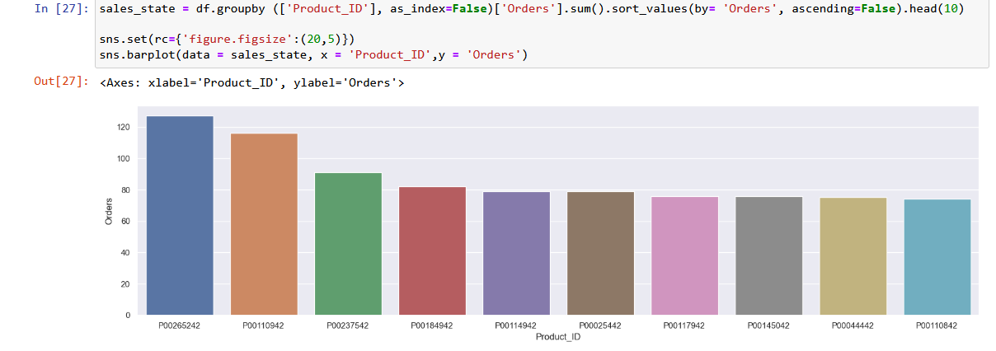

Slide 20
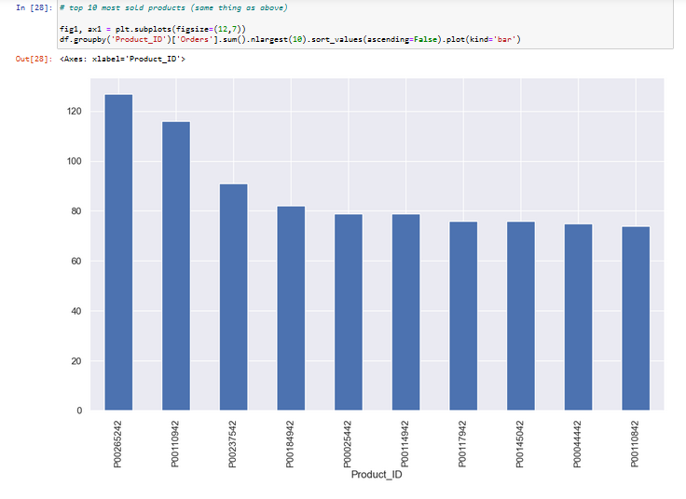

Slide 21
CONCLUSION
Married women age group 26-35 years from UP, Maharashtra and Karnataka working in IT, Healthcare and aviation are more likely to buy products from Food, Clothing and Electronics category.

Slide 22
Questions
What is use of Head () function?
What is use of info () function?
What is EDA?
What is use of graph representation in the project?
Which state spends highest amounts on order?
Which product is purchased by most of the people?

Slide 23
THANKYOU

